Slide 1
Writing an Effective Research Paper
Scarpati Applied Economics Conference
Dr. Aisling Winston

Slide 2
Research Question
Paper Structure
Writing Tips
Resources
Outline

Slide 3
Research Question
What is a research question, and why is it important?
Tips for developing an effective research question
Evaluating your research question

Slide 4
What is a research question, and why is it important?
A research question articulates the issue or problem that will be investigated and how it will be analyzed
Determining and clearly defining the research question is perhaps the most important step in conducting research
Research questions
Define the scope of the study
Direct the line(s) of inquiry
Provide a framework for assessing work and progress

Slide 5
Types of Research Questions (Bouchrika, 2004)
Qualitative
Describe the nature of something or a phenomenon
Descriptive
Assess the effectiveness of an existing method
Evaluative
Examine reasons for phenomena
Explanatory
Investigate little-known topics
Exploratory
Introduce new topics to explore
Generative
Quantitative
Measure the response to variables
Descriptive
Discover differences between groups for an outcome variable
Comparative
Explore trends and interactions between variables
Relationship

Slide 6
Tips for Developing an Effective Research Question (1)
The content of effective research statements
Feasible – the question is within your ability to investigate
Interesting and novel – you, and others, believe the question is worth studying, and studying the question will bring new insight
Relevant and appropriate – the question meets the standards and expectations of the field and/or target audience
The writing of effective research statements
Clear – readers can understand the purpose of the project without additional explanation
Focused – narrow enough to be answerable within the confines of the project
Concise – expressed succinctly
Systematic – the question defines the scope and analytical process
Complex – the answer requires synthesis and analysis (it is not a simple “yes” or “no” question)

Slide 7
Tips for Developing an Effective Research Question (2)
What actions should social networking sites like MySpace and Facebook take to protect users’ personal information and privacy?
This is insufficiently clear or focused (Which sites? What is meant by “harm?”)
Ex: How should social networking sites address the harm they cause?
What is the most significant effect of glacial melting on the lives of penguins in Antarctica?
This isn’t feasible; it cannot be answered in a single paper
Ex: What is the effect on the environment of global warming?
How have school intervention programs and parental education levels affected the rate of childhood obesity among 1st to 6th grade students?
This is too simple; there is no real analysis required to answer the question
Ex: How has childhood obesity changed in the US over the past 10 years?

Slide 8
Tips for Developing an Effective Research Question (3)
Example questions to ask yourself when writing an empirical research question:
What is the population being studied?
What is the exposure, intervention, or causal variable?
(Optional) What is the comparison group?
What is the outcome of interest?
What is the timeframe of interest?

Slide 9
Evaluating Your Research Question
Your research question:
 | Effective | Progressing | Needs Work
Research Question Content
Feasibility | Your question is comfortably within your ability to investigate | Your question is almost within your ability to investigate | Your question is not within your ability to investigate
Interest and novelty | Your question is worth studying and it will bring new insight to the field | It is apparent why others should be interest in your question, but the contribution to the field is not clear | It is not obvious why others should be interested in your question, or your question has been answered before
Relevance and appropriateness | Your question meets the standards and expectations of the target audience | Your question partially meets some of the standards and expectations of the target audience | Your question does not meet the standards and expectations of the target audience
Structure | Your question defines the scope and implies the analytical process of your paper | Your question partially defines the scope and/or partially implies the analytical process of your paper | Your question does not define the scope and/or imply analytical process of your paper
Research Question Writing
Clarity | Readers can understand the purpose of the project without additional explanation | Readers can understand the general purpose of the project but need additional details and explanation | The question is vague, making it difficult for readers to understand the purpose of the project
Focus | Your question is sufficiently narrow to be answerable within the confines of the paper | Your question is slightly too broad to be fully answerable within the confines of the paper | Your question is too broad to be answerable within a paper
Conciseness | Your question is succinct | Your question is clear but could be made succinct | Your question is long and difficult to follow
Complexity | Answering your question requires synthesis and analysis to fully answer | Answering your question requires some analysis but could be summarized with facts or as “yes” or “no” | Your question can be answered with facts or is a “yes” or “no” question

Slide 10
Sources
“How to Write a Research Question” (8 August 2018, George Mason University Writing Center, accessed 2 February 2024)
“How to Write a Research Question” (Imed Bouchrika, 2 January 2024, Research.com, accessed 2 February 2024)

Slide 11
Paper Structure
Introduction
Data and Analytical Approach
Results and Discussion
Conclusion
References and Citations
Background and Literature Review
Non-Empirical Papers

Slide 12
Introduction
The introduction determines whether the reader continues
General formula:
Motivation – Why your topic is worth investigating
Research question – What the paper will do
Contribution – How your work extends or adds to the literature
Method – How you will explore your research question
Preview of findings – What conclusions you draw
Roadmap of your paper

Slide 13
Background and Literature Review (1)
You should assume that your readers are generally, but not specifically, knowledgeable
If your readers will not need much background or institutional knowledge to understand your argument, you may want to consider folding the background into your introduction
If your readers will need to be given considerable background or institutional knowledge to understand your argument, you may want to have a separate background section
Try to limit the background section to only that which is necessary to answer the research question (you can use footnotes as necessary for everything else)

Slide 14
Background and Literature Review (2)
A literature review serves to position your work within the broader literature
Your work should take priority, and you should discuss how you add to other work (rather than being overly critical)
Try to structure your literature review thematically by content and/or method
Try to limit the literature review to that which is directly relevant to your research question and analytical approach
If the literature review is short, you can fold it into your introduction or background section

Slide 15
Data and Analytical Approach (1)
The data section should have two parts:
Describe the data
Name and source of data sets;
Period covered and variables used
Panel, cross-section, or time series
Units of observation and how many observations used
Limitations of the data
Descriptive statistics of relevant data
Tables or plots with means and standard deviations
Other relevant summary statistics for different subgroups
Please be sure to make the names of your variables clear!
Interesting and relevant patterns and relationships from the data

Slide 16
Data and Analytical Approach (2)
Empirical papers should discuss the identification strategy
You must explain how your empirical method will demonstrate the causal relationship that you posit in the data
Write out any regressions that you use
If you use a method that differs from that which is most frequently seen in the literature, explain why you have chosen this method and why it will lead to a more accurate understanding of the causal relationship you are examining
Explain why certain variables are included (or not)
Identify and defend the assumptions that you make
Explain how you handle common statistical issues (bias, missing data, imperfect instruments, etc.)
Explain any additional tests that you will perform and why

Slide 17
Non-Empirical Papers
Non-empirical papers typically put the theory or model first, then any data used to back up the conclusions
First, discuss the framework of analysis that will be used
If this is brief (e.g. a summary of the existing literature), this can go in the introduction
If it is a comparison of existing programs, the explanation should include the aspects being compared (which can also go in the introduction), and the literature review can be folded into the discussion/comparison
If analysis will be conducted using a particular approach (e.g. rational actor model or system-level analysis), this should be explained, though it can be explained in the introduction
Then, if this is a theoretical paper, work through the model and the conclusions drawn from the model
Finally, if there is data to illustrate that the model is appropriate, follow the order of data and empirical approach used by empirical papers

Slide 18
Results and Discussion (1)
Only report and discuss results that directly answer the research question (everything else can go in an appendix)
When presenting tables
PLEASE rename the variables so that your readers know what they are!
Use the footnote of the table to provide information about the data or necessary explanation
Generally, standard errors go in parentheses with the estimate
Generally, asterisks are used to indicate significance

Slide 19
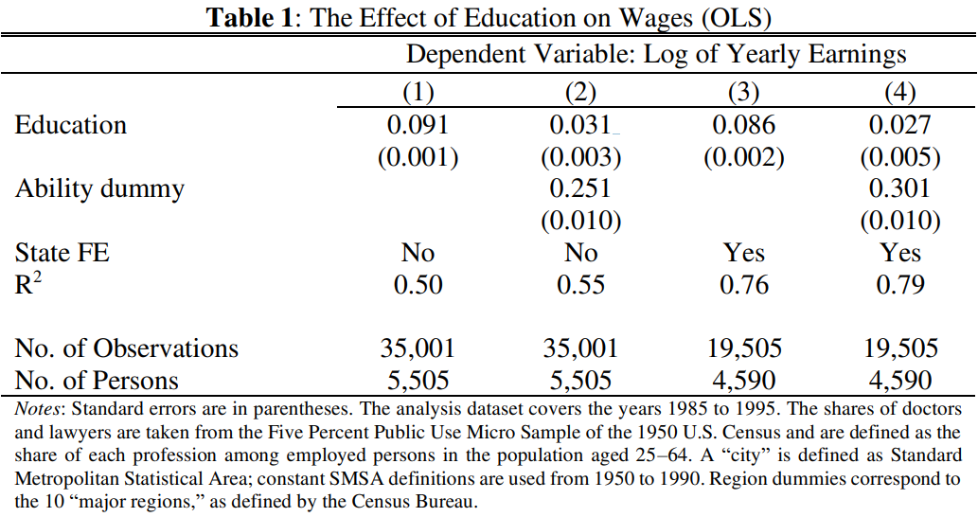
Results and Discussion (2)

Slide 20
Results and Discussion (3)
Introduce, explain, summarize
Before showing results, provide context
After showing results, describe and discuss them
First sentence should be the main takeaway
Remainder of the paragraph should help the reader interpret the results in context and determine how they support your hypothesis
The last sentence should summarize what you have found and how it fits into the bigger picture (connect it back to the research question)
Try to organize your results and discussion such that they tell a story (the story of how you are answering your research question)
You may also wish to discuss the limitations of your research

Slide 21
Conclusion
Common components of conclusions:
Summary of main results
Potential mechanisms driving the results
Limitations of the analytical approach
Potential policy implications
Some suggest including directions for future research; just be careful that these are not things that you should have covered given your research question!

Slide 22
References and Citations (1)
Give credit where credit is due. Always.
If the idea, theory, fact, or evidence comes from someone else, it must be cited
Common knowledge (e.g. the sky is blue) does not need to be cited
Economics papers typically use in-text citations (rather than footnote or endnote citations)
When citing the source of an idea, use the author last name(s) in the text, followed by the publication date in parentheses
“As argued by Smith (1776)…”
When citing the source of supporting evidence, put the author last name(s) and publication dates in parentheses, separated by a comma, with multiple sources separated by semicolons, listed by publication date
“Countries become wealthy by trading (Smith, 1776)…”
“Countries become wealthy by trading (Smith, 1776; Ricardo, 1817)…”

Slide 23
References and Citations (2)
All references should be listed in a “References” section at the end of the paper
Many economics journals use the Chicago manual of style
Other fields (and sometimes economics) often use MLA style or APA style
Pick a manual of style and apply it consistently
ChatGPT (and other large language models) are really good at predictive text, but not so good at economic theory
It can be useful in breaking through writer’s block, editing text, and even coming up with Stata, R, or Python code
Generative AI should be cited if used, even when used for editing
Cite the tool you used (ChatGPT, Gemini, Claude, etc.)
Document how you used the tool (brainstorming, revising text, generating code, etc.) and adapted the content

Slide 24
Sources
“Writing Tips for Economics Research Papers – 2021-2022 Edition” (Plamen Nikolov, IZA Institute of Labor Economics, IZA DP No. 15057, January 2022)
“Academic Writing for Accounting and Economics PhDs” (Dominika Langenmayr, WU Vienna, accessed 5 February 2024)
“Student Guide to Generative AI: Citing Generative AI” (UNC University Libraries, accessed 30 January 2025)
“How to Cite AI Generated Content” (Purdue University Libraries and School of Information Studies, accessed 30 January 2025)

Slide 25
Writing Tips
Writing your research paper
Academic writing conventions
Revising and editing

Slide 26
Writing Your Research Paper
Before starting
Determine your goal (your research question!)
Define your audience
Create an outline!
While writing
Keep your research question in view and refer to it often
Introduce, explain, summarize
First drafts are messy (just write; it’s ok not to use complete sentences, to brain dump, to stop mid-sentence and move on)
While revising
Cut anything that doesn’t directly help to answer the research question
Ensure that paragraphs are cohesive with the most important statement first
Ensure that the structure mimics the thought process
Revise, revise, revise again!
Get feedback early and often
Take notes on your reading, and prepare your citations in advance
Remind yourself of your goal
Keep track of your references as you write
New idea? New paragraph!

Slide 27
Outlining Your Research Paper
Suggestion for General Section Outline
Introduce, Explain, Summarize
Section introduction (with clear thesis statement – what will you be doing in this section?)
Paragraph main idea/thesis statement
Supporting detail
Introduce, explain, summarize
Connect back to section thesis
Supporting detail
Introduce, explain, summarize
Connect back to section thesis
Paragraph conclusion/summary
Additional paragraphs (following structure above)
Conclusion (that summarizes what you have done in the section and connects back to research question)
Your readers are knowledgeable, but they do not have the analysis in their heads like you do
When writing, therefore, help them out!
Introduce the evidence/model you are about to state
What is the evidence/model?
How does it help to support the paragraph/section/paper thesis statement?
Explain the evidence/model
Do not assume that the readers have drawn the same conclusions that you did
Tell the readers what is happening and how they should interpret what you have shown them
Summarize
Remind the readers what they just learned
Remind the readers how this supports the paragraph/section/paper thesis statement

Slide 28
Academic Writing Conventions (1)
Prioritize being clear and easy to understand
Be precise and succinct
Lead with the main idea
Err on the side of explaining (rather than assuming that your reader knows what you are thinking)
Do not use uncommon or made-up abbreviations
Use the active voice
Active voice: The subject does the action
Passive voice: The subject is acted upon

Slide 29
Academic Writing Conventions (2)
Using “I” to talk about what you did is acceptable
When talking about something that you and your readers might be expected to believe, it is fine to use “we”
Try not to use extreme or overly dramatic language
Try to avoid contractions
Use in-text citations when referencing other literature
Comments that you wish to include but that do not directly contribute to your analysis can go in footnotes

Slide 30
Tips for Revising and Editing
Be careful when using Grammarly or Google Docs editing features – suggestions from these can be incorrect
Try revising printed drafts and reading aloud
Do not be afraid to delete
Is the word/sentence/paragraph/idea necessary to prove your point? If not, delete it!
Err on the side of being concise
Seek (and accept) feedback from others
Revise often – writing is rewriting!

Slide 31
Editing Checklist
All extraneous information is deleted, i.e. everything directly supports answering the research question
Language, grammar, style, and citations are consistent
I have visited the Center for Excellence in Writing
I have received feedback from a peer on the readability and understandability of the paper
I have received feedback from a peer and/or faculty advisor on the content
Revising Paragraphs
Revising Sections
Revising the Paper
Each paragraph contains only one idea
The first sentence in each paragraph states the main idea of the paragraph
Paragraphs introduce, explain, and summarize
Each paragraph ends with a summary that reminds the reader of the main idea of the paragraph
Each paragraph supports the goal of the section and the research question
There are clear transitions between paragraphs
Each section begins with an introduction that states the goal of the section and how it supports the research question
The paragraphs are organized logically within sections, so that readers can understand the thought process
Each section contains a conclusion that reminds the reader of the goal and how it supports the research question
The sections are organized logically to help readers understand the thought process
Each section supports answering the research question

Slide 32
Resources
Writing empirical research papers
References and citations
UB resources

Slide 33
Resources for Writing Empirical Research Papers
Writing Tips for Economics Research Papers (Plamen Nikolov, IZA 2022)
Academic Writing for Accounting and Economics PhDs (Dominika Langenmayr)
Structure of a Paper
Introduction
Main Body
Conclusion, List of References, and Appendix
Writing a Research Paper (Purdue OWL)
Tips and Tools for Writing (UNC)
Writing Resources (UB)
The Writing Process (Purdue OWL)
Generative AI (e.g. ChatGPT)
Generative AI in Academic Writing (UNC)
Generative AI in the Writing Process (UMich)
Plagiarism and Academic Scholarship (UB)

Slide 34
Resources for References and Citations
Endnote (UB Libraries)
Style and Formatting Guides (Purdue OWL)
MLA Style
APA Style
Chicago Style
Using Citation Generators Responsibly (Purdue OWL)
Avoiding Plagiarism (Purdue OWL)
Citing Generative AI (UC San Diego)

Slide 35
UB Resources
UB Economics Librarian: Carolyn Klotzbach-Russell
UB Center for Excellence in Writing
UB Research Help
UB Generative AI and Academic Integrity

